Slide 1
Mastering the game of Go with deep neural networks and tree search
David Silver, Aja Huang, Chris J. Maddison, Arthur Guez, Laurent Sifre,
George van den Driessche, Julian Schrittwieser, Ioannis Antonoglou , Veda Panneershelvam, Marc Lanctot, Sander Dieleman, Dominik Grewe, John Nham, Nal Kalchbrenner, Ilya Sutskever, Timothy Lillicrap, Madeleine Leach, Koray Kavukcuoglu
Google DeepMind
Nature 2016
Presented by Yoonsung Kim

Slide 2
introduction
In the game of Go, search space is extremely large(breadth ~ 250, depth ~ 150), therefore exhaustive search is infeasible.
Effective search space can be reduced by position evaluation and action sampling.
Monte Carlo Tree Search(MCTS) was used for search.
Three deep convolutional neural networks were trained.
supervised learning(SL) policy network
Fast rollout policy network
Reinforcement learning policy network

Slide 3
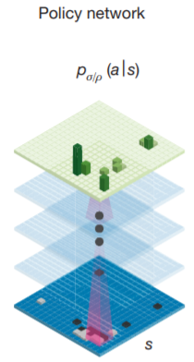

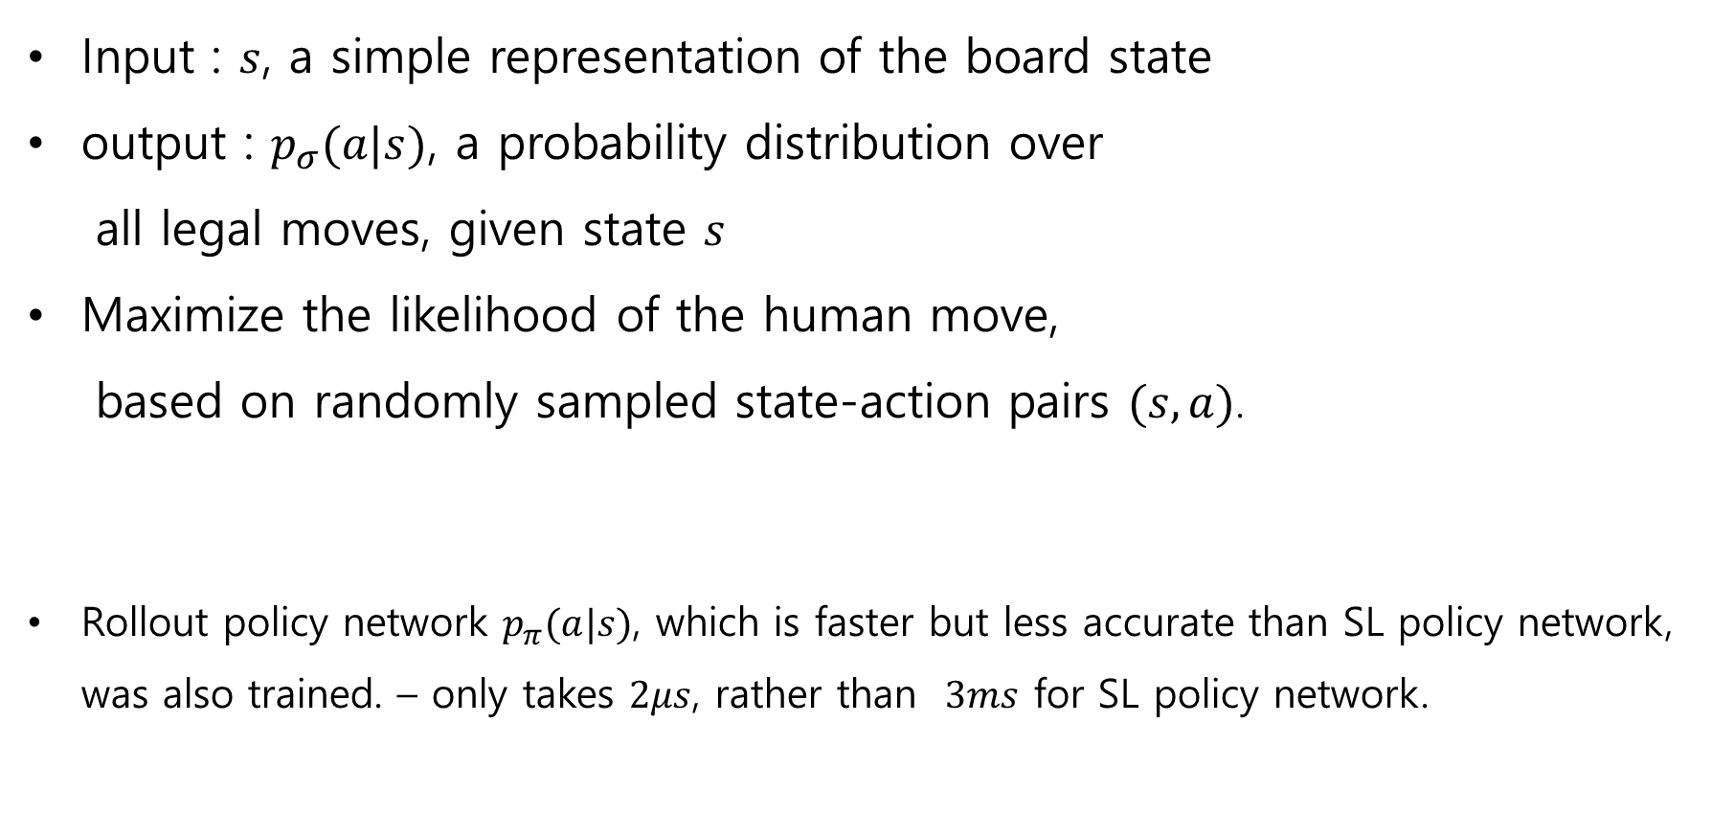
Supervised learning policy networks $p_{σ}$
Input : $s$, a simple representation of the board state
output : $p_{σ}(a|s)$, a probability distribution over
all legal moves, given state $s$
Maximize the likelihood of the human move,
based on randomly sampled state-action pairs $(s, a)$.
Rollout policy network $p_{π}(a|s)$, which is faster but less accurate than SL policy network, was also trained. – only takes $2μs$, rather than $3ms$ for SL policy network.

Slide 4
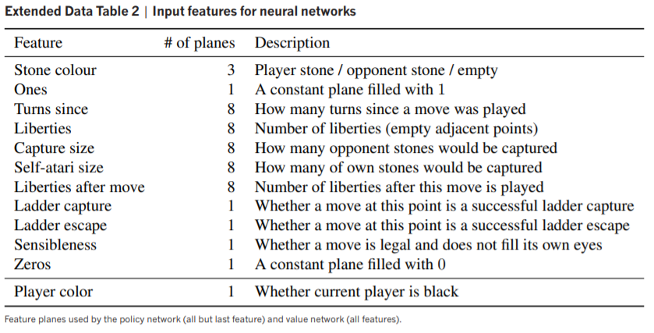
Input features

Slide 5

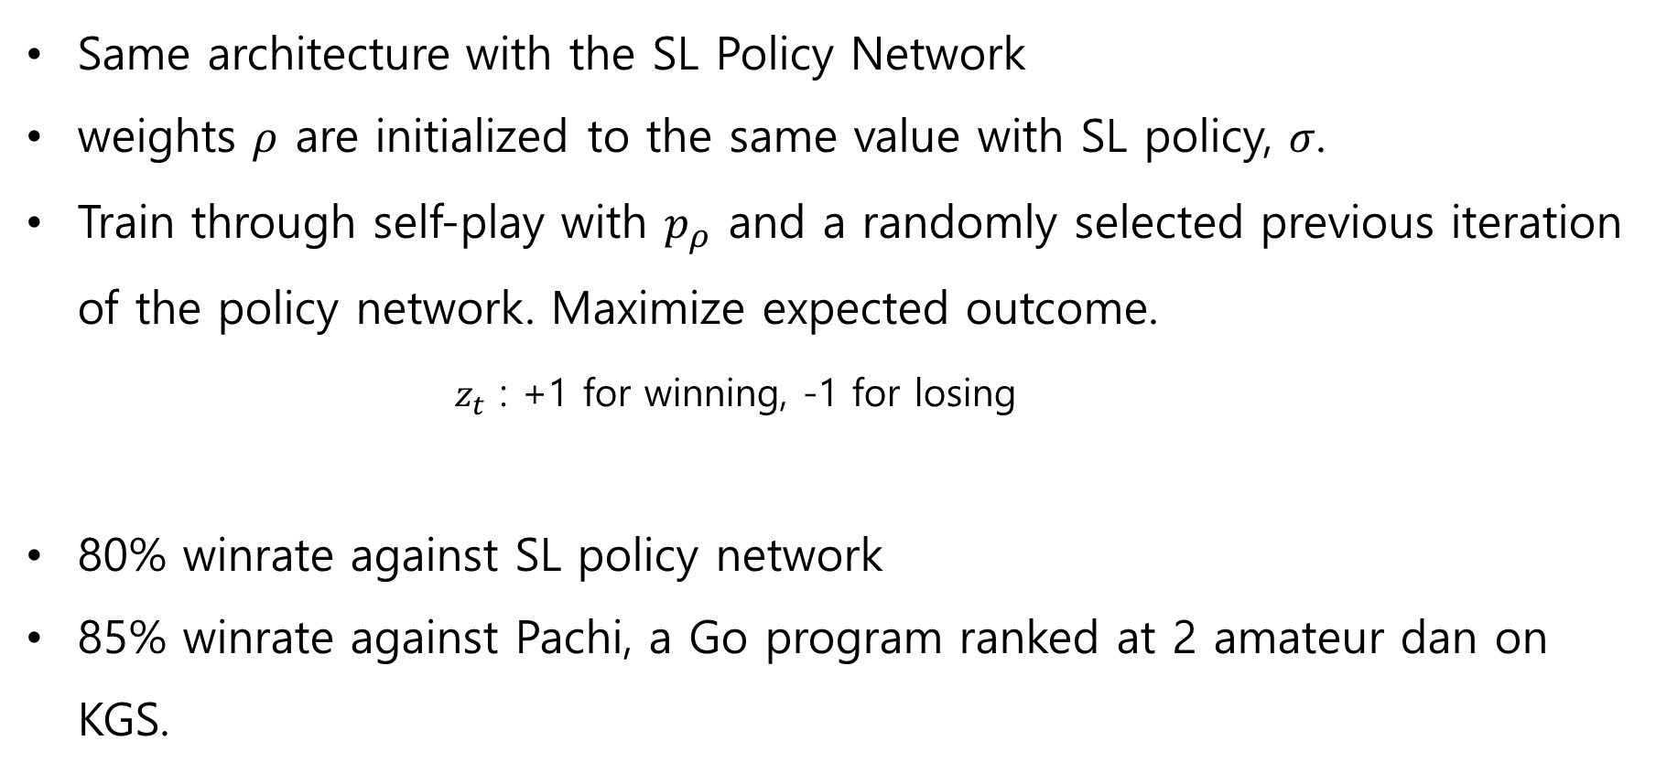
Reinforcement Learning policy networks $p_{ρ}$
Same architecture with the SL Policy Network
weights $ρ$ are initialized to the same value with SL policy, $σ$.
Train through self-play with $p_{ρ}$ and a randomly selected previous iteration of the policy network. Maximize expected outcome.
$z_{t}$ : +1 for winning, -1 for losing
80% winrate against SL policy network
85% winrate against Pachi, a Go program ranked at 2 amateur dan on KGS.

Slide 6
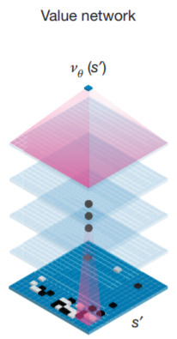

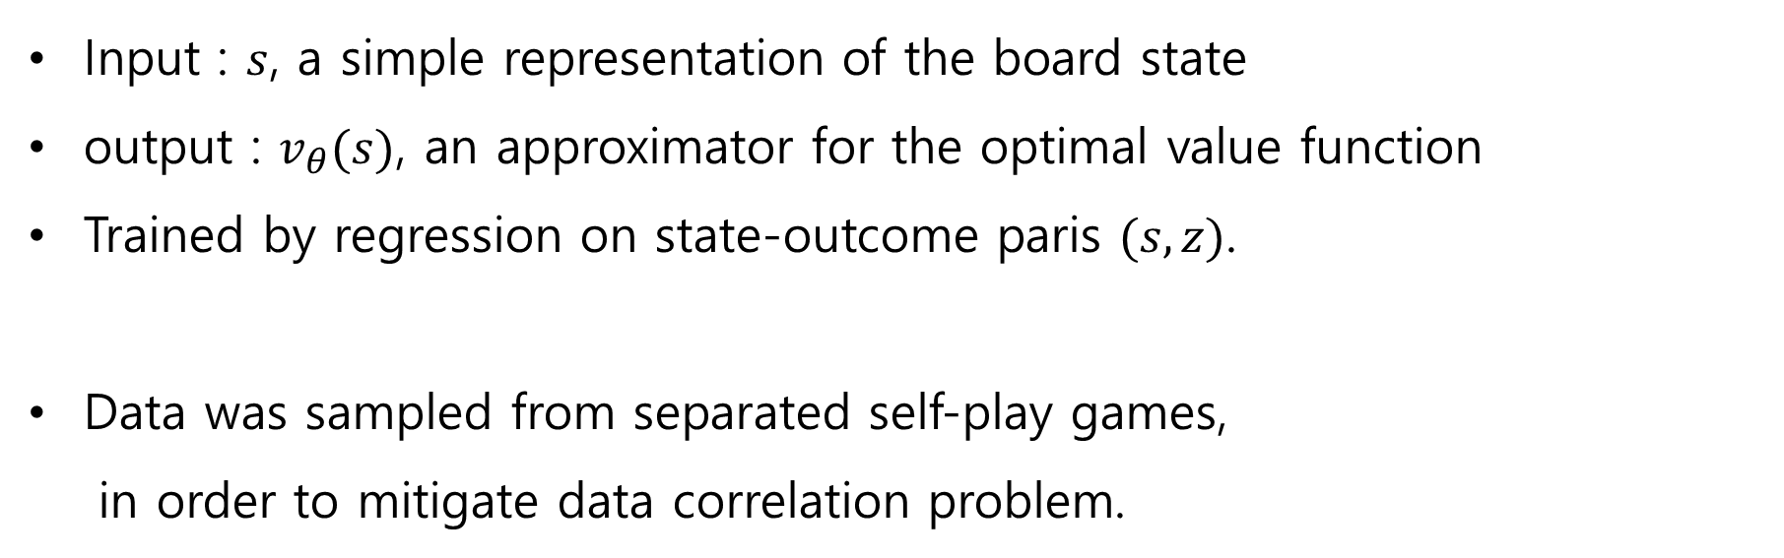
Value networks $v_{θ}$
Input : $s$, a simple representation of the board state
output : $v_{θ}(s)$, an approximator for the optimal value function
Trained by regression on state-outcome paris $(s, z)$.
Data was sampled from separated self-play games,
in order to mitigate data correlation problem.

Slide 7
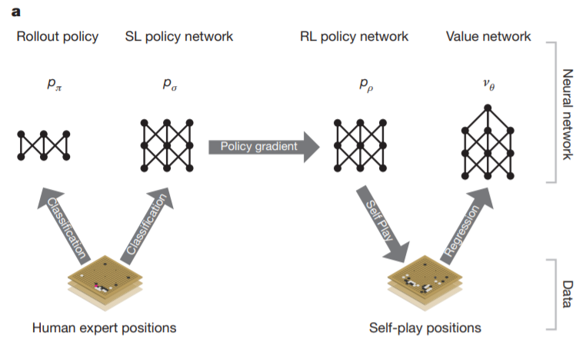
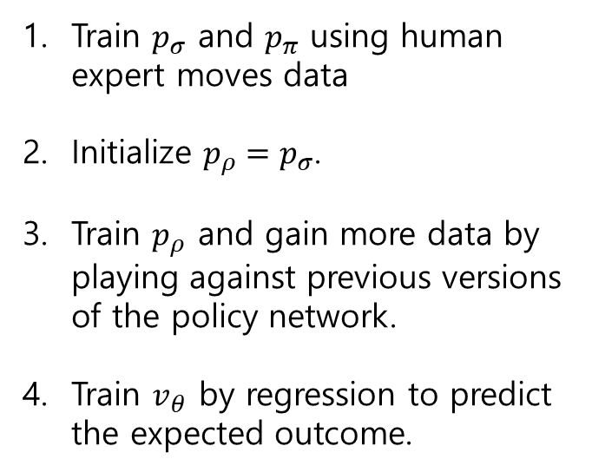
Training pipeline
Train $p_{σ}$ and $p_{π}$ using human expert moves data
Initialize $p_{ρ}=p_{σ}$.
Train $p_{ρ}$ and gain more data by playing against previous versions of the policy network.
Train $v_{θ}$ by regression to predict the expected outcome.

Slide 8
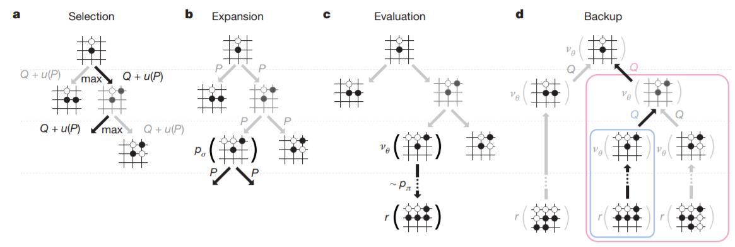
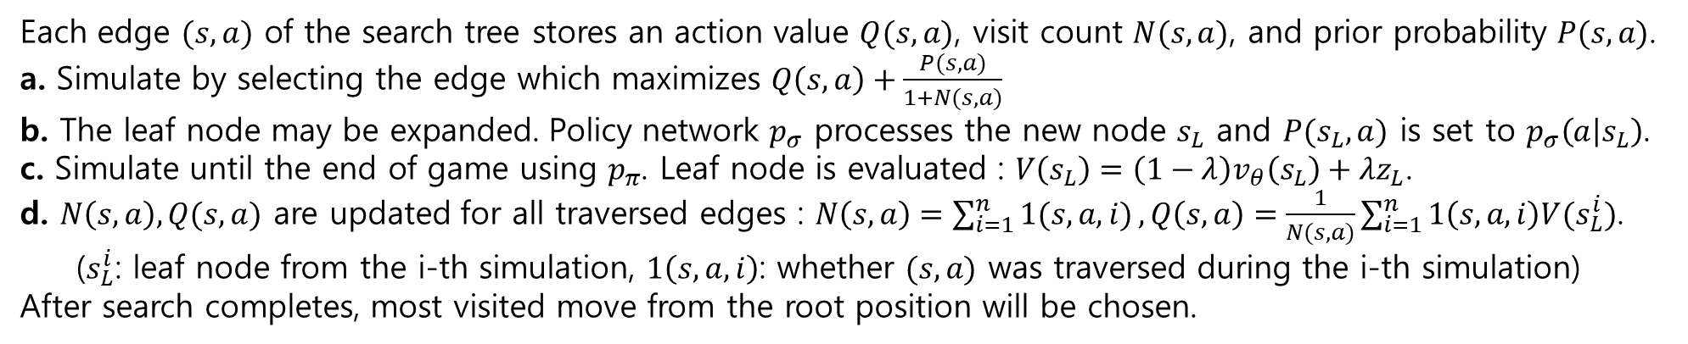
Monte Carlo Tree Search(MCTS)
Each edge $(s,a)$ of the search tree stores an action value $Q(s,a)$, visit count $N(s,a)$, and prior probability $P(s,a)$.
a. Simulate by selecting the edge which maximizes $Q\left(s,a\right)+\frac{P(s,a)}{1+N(s,a)}$
b. The leaf node may be expanded. Policy network $p_{σ}$ processes the new node $s_{L}$ and $P(s_{L},a)$ is set to $p_{σ}\left(a | s_{L}\right)$.
c. Simulate until the end of game using $p_{π}$. Leaf node is evaluated : $V\left(s_{L}\right)=\left(1−λ\right)v_{θ}\left(s_{L}\right)+λz_{L}$.
d. $N\left(s,a\right), Q(s,a)$ are updated for all traversed edges : $N\left(s,a\right)=\sum_{i=1}^{n}{1(s,a,i)}, Q\left(s,a\right)=\frac{1}{N(s,a)}\sum_{i=1}^{n}{1\left(s,a,i\right)V(s_{L}^{i})}$.
($s_{L}^{i}$: leaf node from the i-th simulation, $1\left(s,a,i\right)$: whether $(s,a)$ was traversed during the i-th simulation)
After search completes, most visited move from the root position will be chosen.

Slide 9
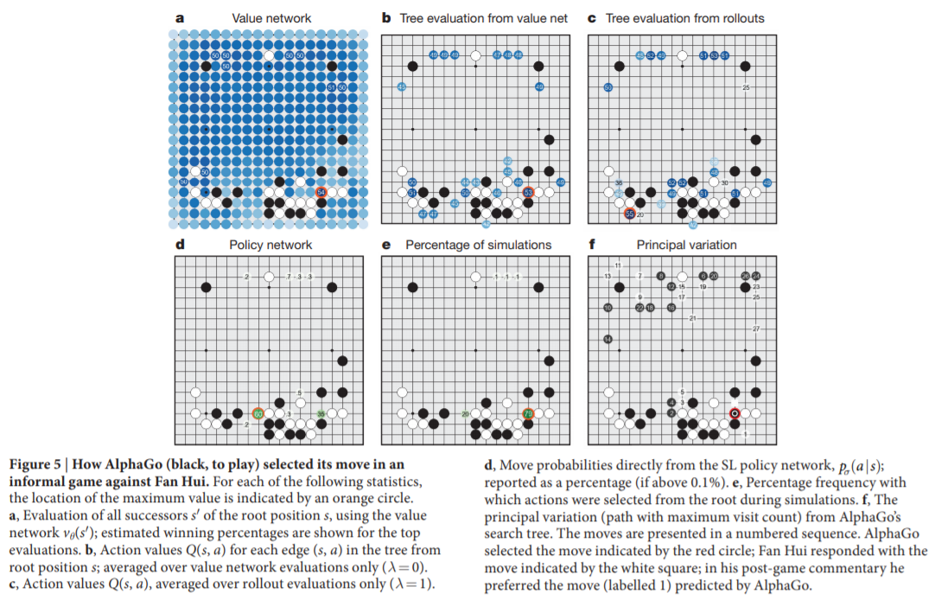
How AlphaGo selected its moves

Slide 10
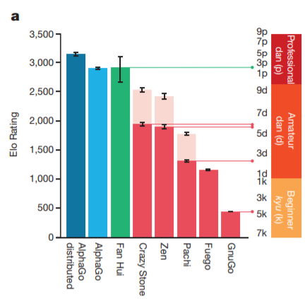
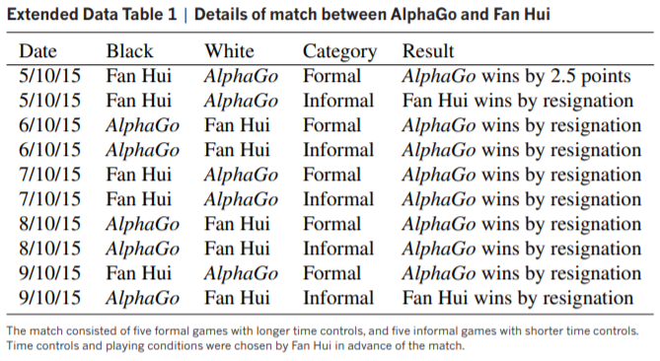
Results
Time for each move : 5s
Pale upper bars : 4 handicap stones

Slide 11
Conclusion
Reached (beyond) pro-level in Go.(As we know, AlphaGo won Lee Se-dol, one of the strongest pro Go player, after publication of this paper)
Introduced a new algorithm that successfully combines Deep Learning and Monte Carlo Tree Search.

